Slide 1

Block Escape
André Sousa (up202005277@fe.up.pt)
Gonçalo Pinto (up202004907@fe.up.pt)
Pedro Fonseca (up202008307@fe.up.pt)
AI First Project

Slide 2
Software used and related work
Stuart Russell, Peter Norvig; Artificial intelligence. ISBN: 978-0-13-207148-2
Richard S. Sutton; Reinforcement learning. ISBN: 978-0-262-03924-6
Stuart Russel, Peter Norvig; Artificial Intelligence: A modern Approach.
https://www.transum.org/Maths/Investigation/CarPark/
PyCharm Professional
Python 3.9
Git

Slide 3
Specification of the work
Goal: take the red block to the exit, while navigating around obstacles on a limited grid.
Project Objectives:
Implement search algorithms to efficiently calculate an efficient path to the exit.
Test and analyze various algorithms and heuristics to determine the best approach for the game.
Algorithms: breadth-first search, depth-first search, iterative deepening, greedy search, A* algorithm and weighted A*

Slide 4
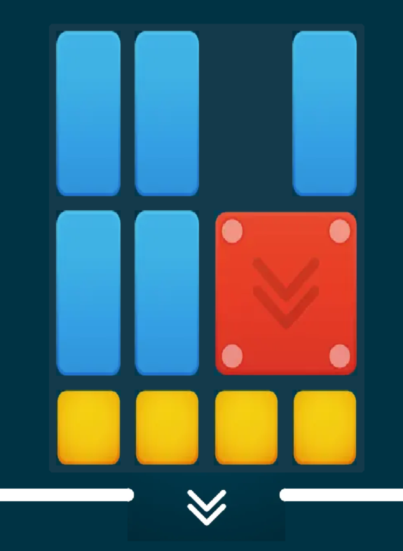
Formulation of the problem as a search problem
Objective Test: The red block is in the exit position.
State Representation: An object Puzzle with defined dimensions and a list of blocks.
Initial State: A board filled with blocks and the red block is blocked.
Operators: move: Move a block to an empty space in the game board.
Preconditions: Enough space adjacent to the current position and the coordinate is valid on the game board.
Cost: 1 move.
Effect: Update the position of the block with the new position.
Heuristics:
H1: Distance from the red block to the exit.
H2: Weighted sum of the number of obstacles between the red block and the exit.
H3: The largest contiguous empty space near the red block.
H4: Prioritize moves that keep the red block close to the edges of the game board.
H5: Always ensure that the red block has at least one valid move option available.
H6: Prioritize fitting pieces along the edges of the game board from largest to smallest.
H7: Prioritize moving the largest pieces on the game board first.
H8: Prioritize moving the smallest pieces on the game board first.

Slide 5
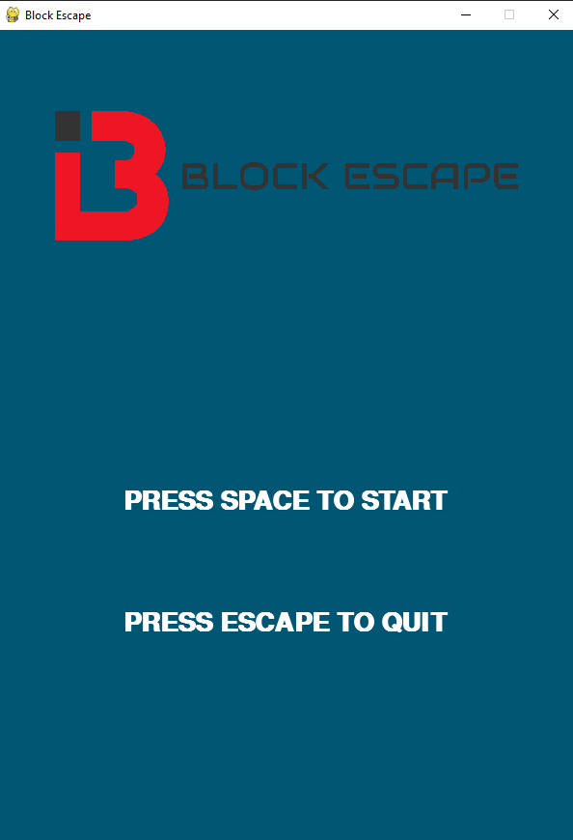
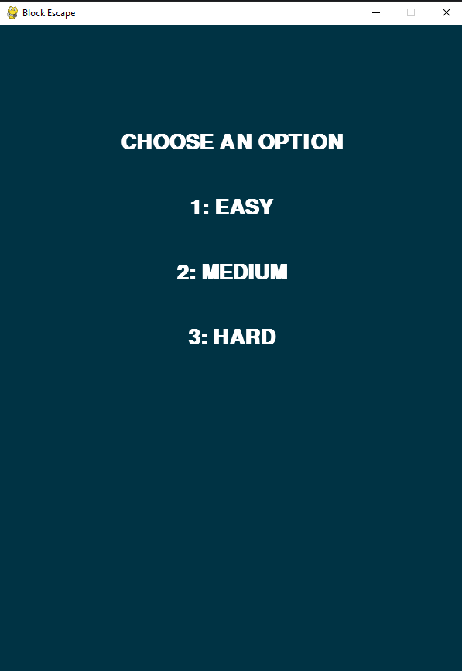
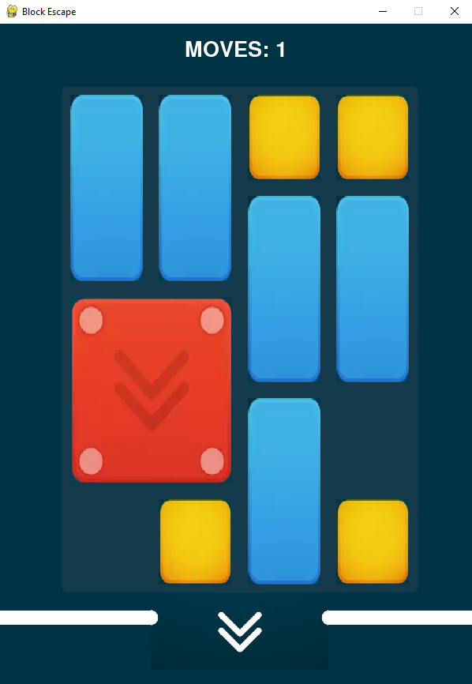
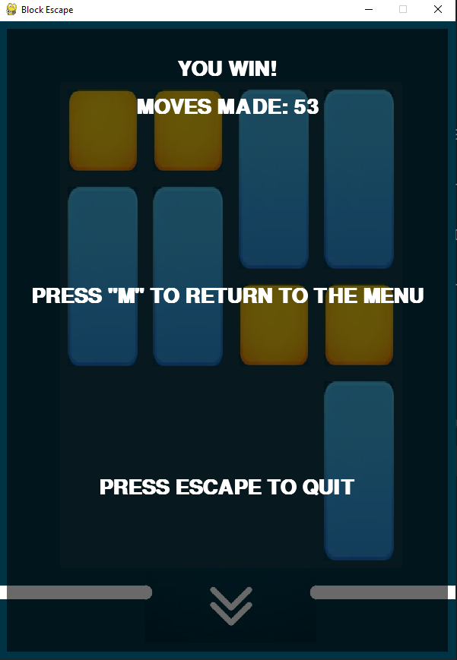
Implementation work already carried out
Menu that allows users to start or quit the game
Difficulty level selection after starting the game
Graphical User Interface (GUI) for piece movements
Game over detection to determine when the game ends
Total moves counter to keep track of the number of moves made

Slide 6
Heuristics and operators
Heuristics:
H1: Euclidean distance between the red block and the exit
H2: Weighted sum of the obstacles between the red block and the exit
H3: Maximize the amount of contiguous empty spaces near the red block
H4: Prioritize moves that keep the red block close to the edges
H5: Prioritize movements in which the red block has at least one possible movement
H6: Prioritize fitting blocks along the edges of the game board from largest to smallest
H7: Prioritize moving the largest blocks first
H8: Prioritize moving the smallest blocks first
Operators:
move: Move a block (up, down, right or left) to an adjacent empty space in the game board.
Preconditions: Enough space adjacent to the current position and the coordinates are valid on the game board.
Cost: 1 move.
Effect: Update the position of the block.

Slide 7

Implemented algorithms
Breadth First Search
Depth First Search
Depth Limited Search
Iterative Deepening Search
Greedy Search
A* search
Weighted A* search

Slide 8
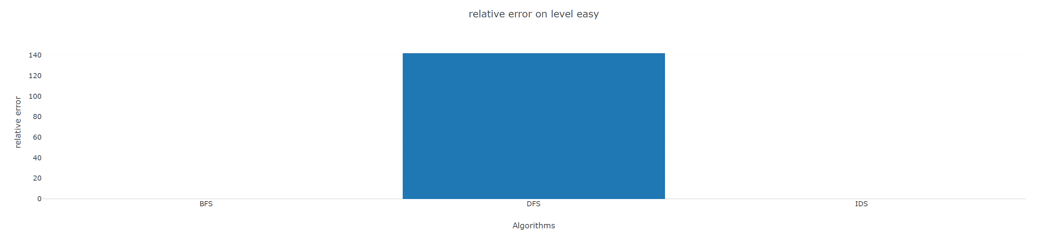
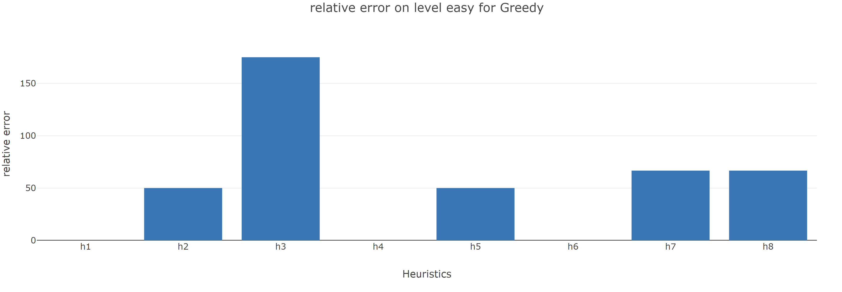
Experimental Results
Full report here

Slide 9
Conclusions
In terms of speed, BFS was found to be slower compared to the other algorithms.
Greedy search, on the other hand, performed differently due to its lack of a cost function.
Prioritizing moves that keep the red block close to the edges of the board was found to be the best heuristic overall.
All the heuristics provided an optimal solution in the A* algorithm.
IDS was slower than DFS but used fewer nodes, making it a good choice when memory is a concern.
The performance of search-based games is heavily influenced by the choice of algorithm and heuristic used.
Our results suggest that BFS is not a good choice for this game.
Greedy search was interesting but did not perform as well as expected.
Prioritizing moves that keep the red block close to the edges of the board provided the best results overall.
All heuristics provided optimal solutions in the A* algorithm.
IDS was found to be slower than DFS but used fewer nodes, making it a good alternative to DFS in scenarios where memory is a concern.
Overall, our findings highlight the importance of carefully selecting the appropriate search algorithm and heuristic for a given search-based game.

